Slide 1
Unit 202: Principles of electrical science
Sine waves
quantities

Slide 2
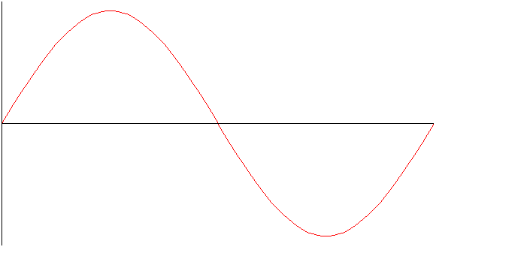
Sine waves

Slide 3
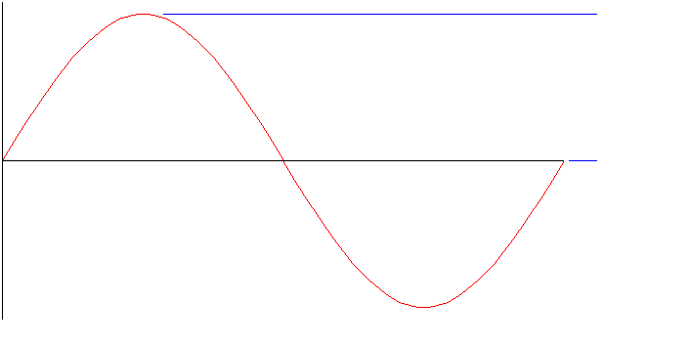
Sine waves
Peak
voltage

Slide 4
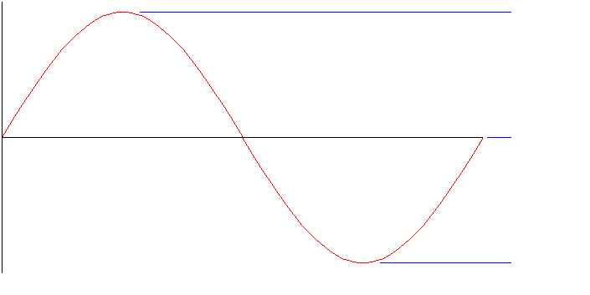
Sine waves
Peak
voltage
Peak
voltage

Slide 5
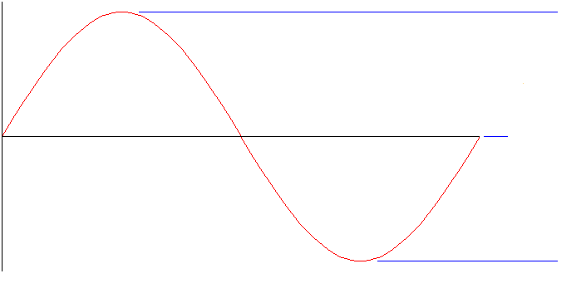
Sine waves
Peak
voltage
Peak to
peak
voltage
Peak
voltage

Slide 6
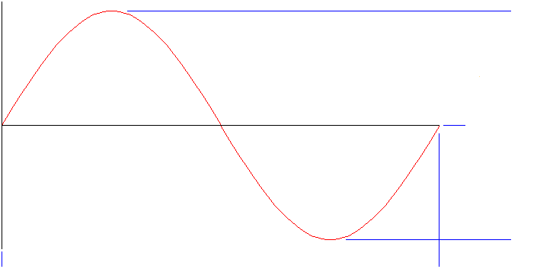
Sine waves
Peak to
peak
voltage
1 cycle

Slide 7


Sine waves

Slide 8
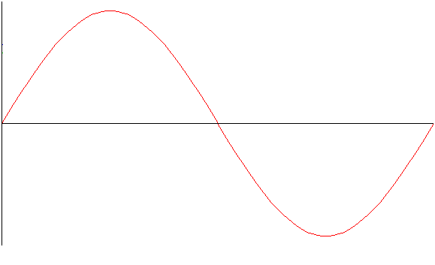


Sine waves
RMS value
RMS value (= 0.707 x peak value)
Average value (= 0.636 x peak value)

Slide 9
Sine waves
Average value

Slide 10
Sine waves
RMS value

Slide 11
Unit 202: Principles of electrical science
The End

